Slide 1
1st Lab
JEONGHUN KIM

Slide 2
Introduction
IDE
repl.it (https://repl.it/languages/python3)
Pycharm (https://www.jetbrains.com/ko-kr/pycharm/download/#section=windows)
TA Information
#409 in Hanbit Bldg.
김정훈 - h1103j@kangwon.ac.kr

Slide 3
In Lab Session
Every lab session class, a couple of problems will be assigned
A short introduction to the problems will be given by TA
if you finish the assignments, Your results should be uploaded to the Eruri system
Please refer to the lecture class, TA will give some help

Slide 4

Lab. Title
Print and Input practice

Slide 5
Let’s start

Slide 6
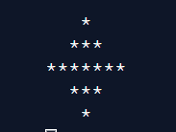
Lab#1
마름모를 출력하시오.

Slide 7
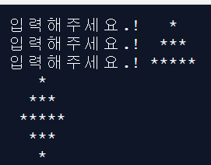
Lab#2
사용자로부터 입력을 받아서 마름모를 출력하시오.

Slide 8
Submit
Upload your source code (py) and result (jpg)

Slide 9
Thanks

